Slide 1

New Public Web
Engineering amazing experiences using Adobe Experience Cloud
Srinivas Gopinath Parimi
Cloud Solutions Architect
15 June 2022

Slide 2
Content
1
Conceptual Architecture
4
CI/CD
7
Governance
2
Logical Architecture
5
Development model
8
Effort estimation
– ADX SPA Analytics
3
Physical topology
6
Main features
9
Appendix

Slide 3










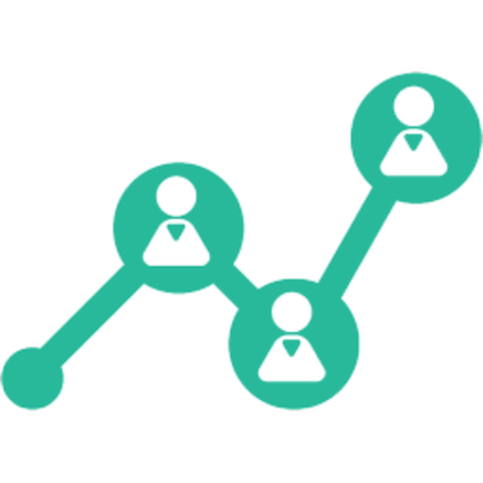



Concept: Next-gen Insurance Solution
Research
Buy
Engage
Advocate
Consistent and relevant experiences across all channels
Web Portal
Mobile App
Customer care
Chatbot
Experience Orchestration
Product
Catalogue
Document Management
Next Best Actions
Campaigns
Workflows
Forms
Integrated Microservices
Claims
Underwriting
Policies
Compliance
Reporting
Notifications
Single
source of truth
Customers
Claims
Medical
Other Data

Slide 4







Concept: Next-gen Insurance Solution
Research
Buy
Engage
Advocate
Angular
React
Web Portal
Mobile App
Customer care
Chatbot
Payments
…
Adobe
Experience Cloud
Product
Catalogue
Document Management
Next Best Actions
Campaigns
Workflows
Forms
GraphQL
REST
SSO
Claims
Underwriting
Policies
Pega
Compliance
Reporting
Notifications
Microservices
Customers
Claims
Medical
Other Data

Slide 5











Logical Architecture: New Public Web
New Public Web
WAF + CDN
DCE Forms
ADX components
Static content
Angular
Adobe Target
Adobe Analytics
…
Dispatcher
Pega
GraphQL
REST
AEM Publish
AEM Author

Slide 6
















Physical topology – Production environment
AWS Region - London
SaaS
VPC
Load Balancer
Availability Zone 1
Availability Zone 2
Adobe Analytics
Adobe Target
Public
subnet
Public
subnet
Route 53
Dispatcher 1
Dispatcher 2
Public
subnet
Public
subnet
Bitbucket
Jira
S3
AEGON datacentre
AEM Publish 1
AEM Publish 2
Private
subnet
Active Directory
Jenkins
CI
AEM Author
Direct Connect
Pega
Others

Slide 7
Physical topology – Staging / UAT environment
AWS Region - London
SaaS
VPC
Load Balancer
Availability Zone 1
Availability Zone 2
Adobe Analytics
Adobe Target
Public
subnet
Public
subnet
Route 53
Dispatcher 1
Dispatcher 2
Public
subnet
Public
subnet
Bitbucket
Jira
S3
AEGON datacentre
AEM Publish 1
AEM Publish 2
Private
subnet
Active Directory
Jenkins
CI
AEM Author
Direct Connect
Pega
Others

Slide 8
Physical topology – Development environment
AWS Region - Ireland
SaaS
VPC
Availability Zone 1
Adobe Analytics
Adobe Target
Public
subnet
Route 53
Dispatcher 1
Public
subnet
Bitbucket
Jira
S3
AEGON datacentre
AEM Publish 1
Private
subnet
Active Directory
Jenkins
CI
AEM Author
Direct Connect
Pega
Others

Slide 9
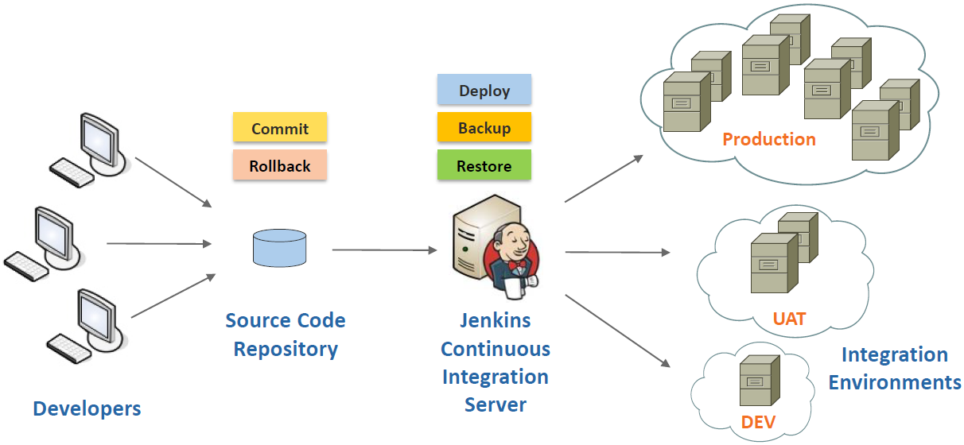
Continuous Integration
Reliable Deployment. Agile Development. On-demand update.
SECURITY. SCALABILITY. SEAMLESS INTEGRATION. STREAMLINED DELIVERY.

Slide 10



DevOps workflow
Test Automation Suites
Create feature branch (Jira ticket)
Commit and push to branch
Code quality check
Unit-testing
Peer-review
Merge to main branch
SAST / DAST
Trigger build on merge
Ticket for user story
Build & Deploy
DEV / UAT / Production
Jira
Developer
Bitbucket
Jenkins
Promote
DEV → UAT
UAT → Production
Backup & Restore
DEV / UAT / Production
Trunk-based development and deployment

Slide 11

UI Component Development Method
AEGON AXLE
Design System
Production environment
Import
Design library
from Aegon
Develop components
Code quality check
Unit-test
Peer-review
Push code
Build
Test
Deploy
Staging environment
UI Developer
DevOps Pipeline
Dev & Test environment

Slide 12

ADX – Analytics Integration
Define Tags, Events and rules
Generate Launch code that acts as an agent or Adobe Analytics
Adobe Launch
Import Launch code
Develop UI with Analytics
Deploy to hosting environment
Portal sends data to Adobe Analytics Cloud Service
ADX components
Adobe Analytics
Angular
Web portal with ADX components

Slide 13

Main features
Adobe Experience Cloud

Slide 14
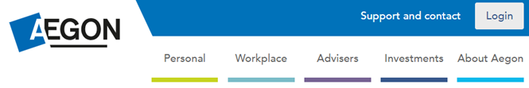
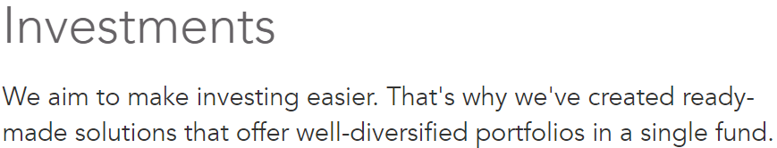
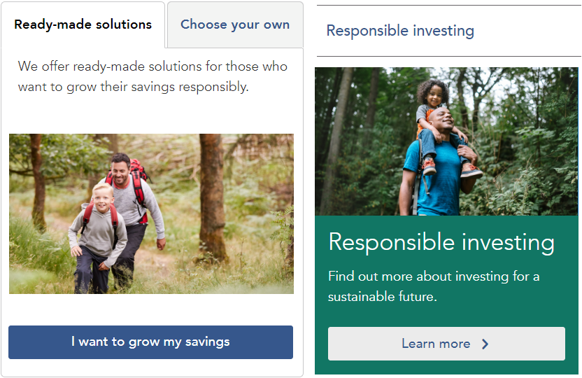
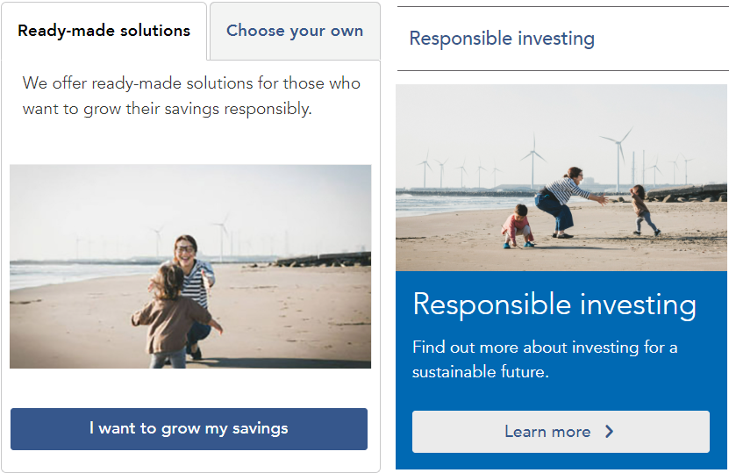
Experience personalisation
Adobe Target can dynamically render personalized variations for the experiences.
Variations can be based on criteria like user profile, demography, search query, Aegon API response, etc

Slide 15








Customer journey orchestration
Discover
Nurture
Convert
Engage
Prospects become customers
Prospects
Multi-channel
Conversations provide insights:
Interests
Lifestyle
Proximity
Demography
Next-Best-Actions triggered
for the Prospects, based on the insights and the defined Business rules
Personal Offers
Signup Forms
Cross-sell & Up-sell
Social Media
3. Referral
1. Identify Prospects
Adobe
Marketing Cloud
Adobe Marketing Cloud
AEM
Data-driven Marketing
360-degree view on Customer
Interaction History
Managed Outbound Communication
Sales /
Conversions
ROI
Analytics
Feedback
Business /
Agents
2. Trigger Referral
Business /
Agents
Business /
Agents
Business
Customers
Business users can design, test and launch customer journeys without the involvement of IT staff or development team

Slide 16
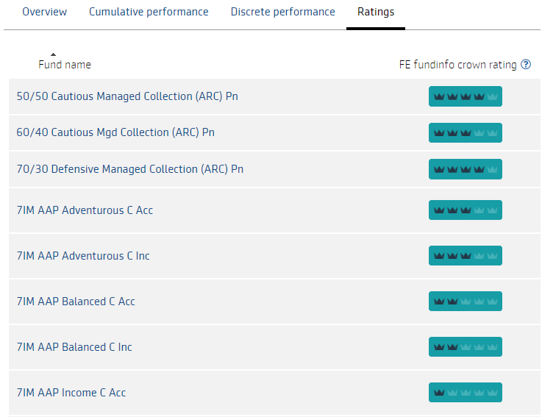

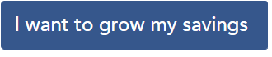

Continuous content enrichment
AEM
Modify and test content
Launch tested content
Push
relevant content
dynamically
Target
Tracking and analysis
Analytics
Update presentation strategy as per the analysis
Adobe Analytics and Target provide a feedback loop for continuously enriching the personalized content

Slide 17
Team Structure
Aegon stakeholders
Solution Development Team
Consultants / Partners
Digital Strategy
Project Manager
Content Strategist
Business Analyst
Adobe Cloud Solutions Architect
Account Management
Business
Training
IT Security
QA Lead
QA Engineers
Tech Lead
Developers
UX Lead
Editors
Staff augmentation
Operations
Procurement
Reporting
Governance
Compliance
Stakeholder engagement
Recommended for AEM development [Srinivas Gopinath Parimi]

Slide 18
Development Cycle
Content Strategist validates site structure, URLs, site maps and taxonomy
← BUILD, VALIDATE, REFINE ---
Sprint backlog
User story refinement
Estimation
Code passes quality check and unit testing
Business approval for go-live
Content editing
SEO
Re-directs
Design
DEV
Sprint 2
QA
UAT
Go-live prep
Launch
Client Demo
Sprint Retrospective
Stakeholder report
Coding and reviewing
Recommended for AEM development [Srinivas Gopinath Parimi]

Slide 19
Development methodology
Discover
Design
Develop
Deploy
Sprint 1
Sprint 2
Sprint n
Understand
Explore
Execute
Understand
Explore
Execute
Understand
Explore
Execute
Define
Decide
Validate
Define
Decide
Validate
Define
Decide
Validate
Each agile sprint is of 2 weeks in duration
Recommended for AEM development [Srinivas Gopinath Parimi]

Slide 20
Content Publishing Process
1. Identify the list of pages to be published
2. Create ‘Launch’ version for the content to be published
3. Edit content, Analytics variables and Targeted personalisation
5. Verify Accuracy, Accessibility and Readability of content
7. Submit the Launch pages for review and approval by Aegon
10. Publish approved ‘Launch’ pages to live environment.
4. Validate Sitemap, SEO, URL Redirects and Links
8. Get Aegon approval for publishing pages
6. Create ‘Launch’ version for the set of pages to be published
9. Aegon Change Control process for publishing the launch pages.
Recommended for AEM sites [Srinivas Gopinath Parimi]

Slide 21
Project Governance
3 Tiers & 2 Pillars governance model offers Aegon tight control and transparency throughout the project, along with leverage on digital practice and support systems of partners
Risk Mitigation
Value Enhancement
Risk & Compliance
Contracts
Financials
Change
Quality
Relationship
Forums
AEGON
Partner
Input
Output
Participants
Strategic
Governance
Project
Steering
Committee
CTO/CIO
Executive sponsor
Program Director
Project Manager
Engagement dashboard,
Innovation,
Best Practices
Future Strategy, Service
Quality Assessment
Quarterly
Tactical
Governance
Project Working Committee
Client IT head
Project Manager
Senior Support analyst
Monthly SLA Report, Unresolved escalations, Risk Assessment
Demand Prioritization, Change Approval, Improvement Opportunities
Monthly
Operational
Governance
Operations meetings
Application Leads
Project Manager
Senior Support Analyst
Weekly report,
Performance issues, Non-core demand requests
Volume management, fulfilment, Review SLAs, Billing issue resolution
Weekly
Recommended for AEM development [Srinivas Gopinath Parimi]

Slide 22
Effort estimation – ADX SPA Analytics
ADX SPA Analytics
Solution Development Effort
# | Category | Journey | Size | DEV | QA | Mgt. | Hours | Days
1 | Adviser | Activation | L | 90 | 18 | 9 | 117 | 15
2 |  | Login | S | 30 | 6 | 3 | 39 | 5
3 |  | Account | M | 60 | 12 | 6 | 78 | 10
4 |  | Quote & Apply | XL | 160 | 32 | 16 | 208 | 26
5 |  | Buy new product | XL | 160 | 32 | 16 | 208 | 26
6 |  | Change existing investments | M | 60 | 12 | 6 | 78 | 10
7 |  | Manage regular money in | L | 90 | 18 | 9 | 117 | 15
8 |  | Manage investment | M | 60 | 12 | 6 | 78 | 10
9 |  | Top up | S | 30 | 6 | 3 | 39 | 5
10 |  | Equity trading | S | 30 | 6 | 3 | 39 | 5
11 |  | Ongoing Adviser change | M | 60 | 12 | 6 | 78 | 10
12 |  | Adhoc Adviser change | M | 60 | 12 | 6 | 78 | 10
13 |  | Drawdown | L | 90 | 18 | 9 | 117 | 15
14 |  | Manage money out | L | 90 | 18 | 9 | 117 | 15
15 | Customer | Activation | S | 30 | 6 | 3 | 39 | 5
16 |  | Unlock Account | S | 30 | 6 | 3 | 39 | 5
17 |  | Forgot password | S | 30 | 6 | 3 | 39 | 5
18 |  | Buy new product | XL | 160 | 32 | 16 | 208 | 26
19 |  | Change existing investments | S | 30 | 6 | 3 | 39 | 5
20 |  | Manage regular money in | S | 30 | 6 | 3 | 39 | 5
21 |  | Manage investment | S | 30 | 6 | 3 | 39 | 5
22 |  | Top up | S | 30 | 6 | 3 | 39 | 5
23 |  | Equity trading | S | 30 | 6 | 3 | 39 | 5
24 |  | Manage money out | S | 30 | 6 | 3 | 39 | 5
25 | Employer | Activation | M | 60 | 12 | 6 | 78 | 10
26 |  | Unlock Account | L | 90 | 18 | 9 | 117 | 15
27 |  | New user | S | 30 | 6 | 3 | 39 | 5
28 |  | Manage members | S | 30 | 6 | 3 | 39 | 5
29 |  | Add new members | S | 30 | 6 | 3 | 39 | 5
30 |  | Manage contributions | L | 90 | 18 | 9 | 117 | 15
31 |  | Scheme and template | M | 60 | 12 | 6 | 78 | 10
32 | DevOps | Environment setup, CI/CD | XL | 160 | 32 | 16 | 208 | 26
Team size
Role | Number | Person days | Daily util | Actual days | Actual weeks
Manager | 1 | 26 | 0.5 | 52 | 11
Business Analyst | 1 | 26 | 0.5 | 52 | 11
Solution Architect | 1 | 13 | 0.25 | 52 | 11
Developer | 5 | 257 | 1 | 52 | 11
DevOps Engineer | 1 | 20 | 1 | 20 | 4
QE | 2 | 52 | 1 | 26 | 6
Effort Estimation
 | Hours | Days | Person weeks
Coding | 2050 | 257 | 52
Testing | 410 | 52 | 11
Management | 205 | 26 | 6
Total | 2665 | 334 | 67
User journeys (Miro board):
https://miro.com/app/board/uXjVOS58cqU=/

Slide 23

Appendix
References and additional information

Slide 24



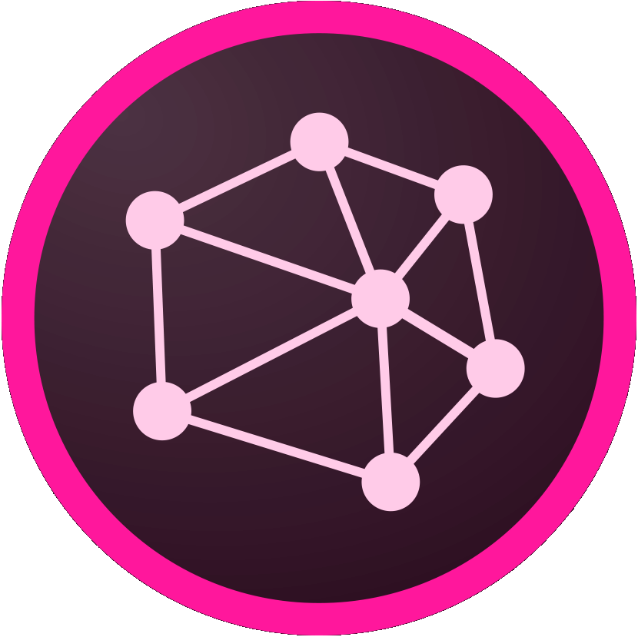

Adobe cloud services
Adobe cloud services recommended for Insurance Industry
Marketing Strategy | Identify prospects and their interests |  |  | Enhance prospect/customer information |  |  | Multi-channel communication
Use Cases | Generate Social Leads | Next Best Action | Trigger Customer Referral | Monitor Prospect Interaction | Track Interaction History | Track Prospect’s Proximity | Outbound Messages | Inter-channel Handshake | Peer Analytics
I want to | Identify prospects via social media | Understand prospects through intelligent analytics and shortlist for follow-up | Predict and assign the leads to channels and users for follow-up | Monitor the prospect's interactions through specific channels to build a comprehensive view of the customer/prospect. | Track the interactions across various channels enabling agents/call center to get a 360 degree of the customer interactions. | Track prospect’s location to check if any agent is in proximity to personally connect with the prospect | Manage all the outbound communications made with the prospect through any channel like call, SMS, email, WhatsApp etc. | Enable seamless transfer of channels resuming interaction from where it was left in the last interaction. | Use a peer-based sales model to suggest the appropriate product to the prospect or customer.
Solution Components
Experience Manager
Audience Manager
Analytics
Campaign
Media Optimizer
Social
Target
24

Slide 25
Benefits of Adobe Target
Item Boosting
Intuitive Marketer controls for high degree of customized presentation and messaging.
Automated Recommendations
Eliminate expensive, time-intensive manual approaches to recommendations.
Engage, Cross-sell, Upsell
Recommendations for every context - Home page, Product pages, Checkout, e-mail.
Target
Enrich with Analytics
Integrate with Analytics to eliminate “cold start,” and optimize effectiveness with unique business metrics.
Monitor, test, and optimize
Test & compare recommendations.
Monitor real-time performance.

Slide 26
Benefits of Target + Analytics
360-degree customer analysis
Build customer profiles with online and offline information
Customer Journey Optimization
Understand all points of interaction with customers to improve selling opportunities
Propensity Scoring
Predict which customers are the most likely to convert, so that they can be targeted efficiently.
+
Target
Analytics
Live Stream
See what’s happening right now with your site visitors through real-time event visualization.
Contribution analysis
Intelligently identify potential causes for anomalies in trended data.

Slide 27
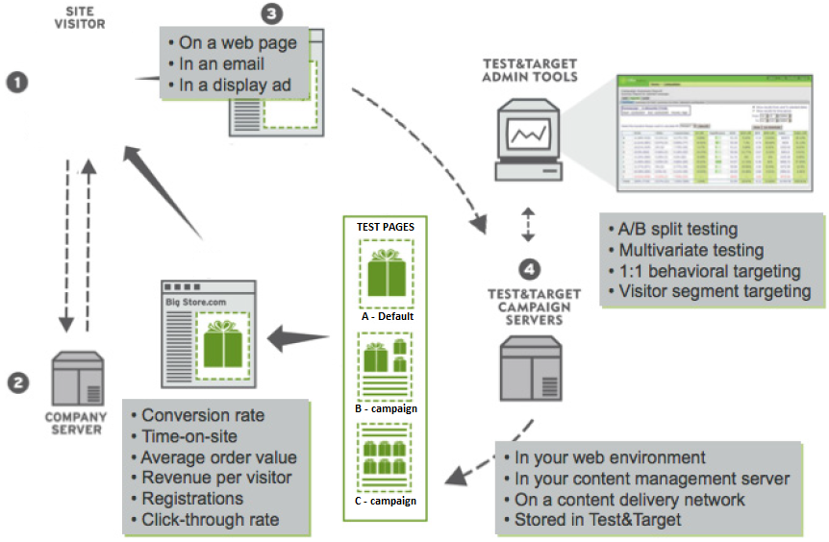

How Adobe Target works
Customer opens a webpage
Page is rendered along with Adobe M-boxes*.
M-box sends the page context to Adobe Target service and requests for relevant content
Adobe Target renders the relevant content to the m-boxes according to the campaign rules.
*M-box stands for 'Marketing Box’.
It is a designated area on the web page, which is meant for promotions and campaigns managed by Adobe Target.

Slide 28


